Slide 1
Decentralized Charity Platform

Slide 2
Project overview
The Decentralized Charity Platform (DCP) is designed to allow people to contribute to charitable causes using Ethereum-based cryptocurrency donations. It leverages blockchain technology to ensure transparency, traceability, and security in the donation process. The platform uses smart contracts to manage donations and provide full accountability for every transaction, ensuring that funds reach the intended charity directly without intermediaries.

Slide 3
Key features
Charity Selection & ETH Donations
Select from a list of trusted charities and donate Ethereum (ETH) securely.
MetaMask Integration & Transaction Transparency
Seamlessly connect MetaMask for donations, with transactions recorded on the Ethereum blockchain for full transparency.
Secure & Decentralized
Direct donations through smart contracts, eliminating intermediaries and ensuring security.
Donation History & Real-Time Updates
Track donation history, receive receipts, and get instant updates on donation status.
User-Friendly & Open Source
Intuitive interface built with React.js, open-source code for transparency and community contributions.

Slide 4
System Architecture
Frontend (User Interface)
Built using React.js, allows users to browse charities, select one, and donate Ethereum (ETH) through MetaMask.
Smart Contracts (Blockchain Layer)
Deployed on Ethereum using Solidity, handles charity management, donation processing, and ensures transparency by recording all donations on the blockchain.
MetaMask Integration
Users connect their MetaMask wallet for donation transactions, allowing secure ETH donations directly to selected charities.
Donation Transparency
Blockchain ensures complete transparency, with every donation verified and recorded on the Ethereum ledger for accountability.

Slide 5
Smart contract function
addCharity: Allows the contract owner to add a new charity.
donate: Allows users to donate to a specific charity.
confirmDonation: Allows a charity to confirm receipt of a donation (used for demonstration purposes).
isDonationConfirmed: Checks if a specific charity has confirmed a donation from a particular donor.
receive: A fallback function to receive Ether directly.

Slide 6
User Interaction Flow
Connect to metamask wallet
Select the charity is trustworthy or not
Enter the donation amount.
Donate now
list the donation history with time and date to particular charity
Check the donation status

Slide 7
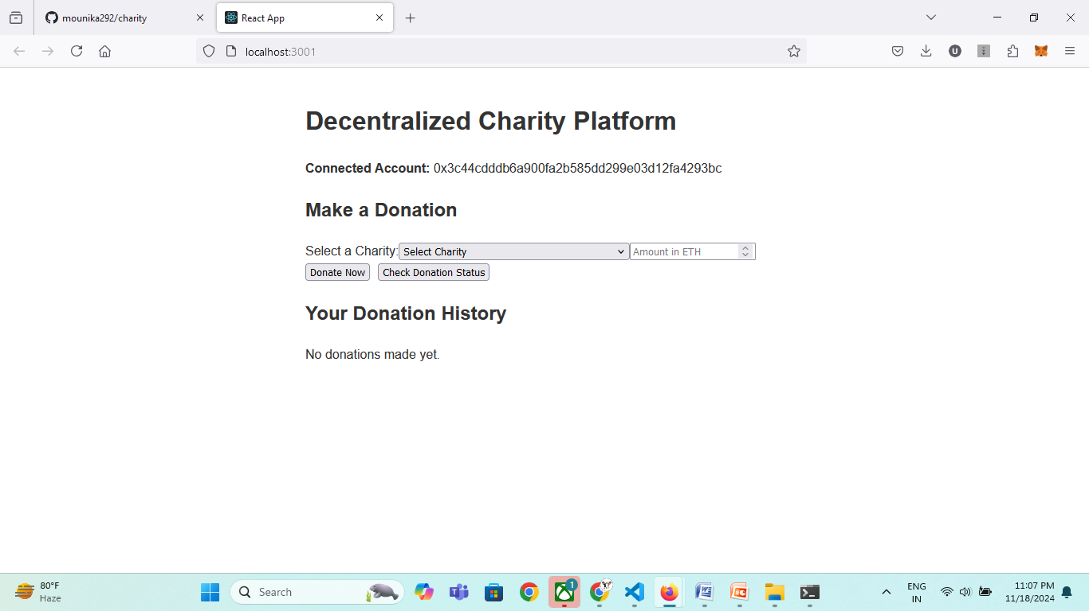
Screenshots

Slide 8
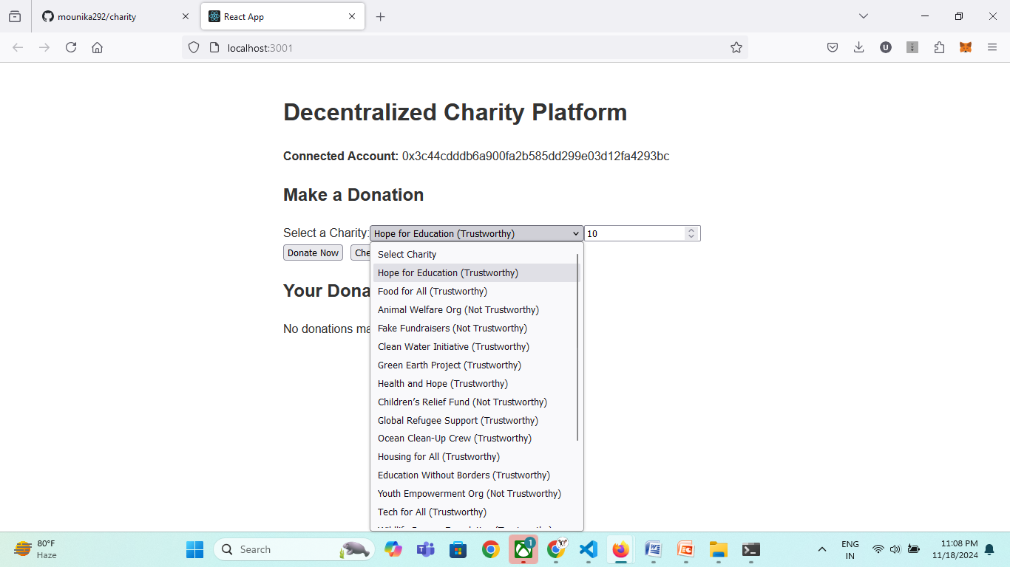

Slide 9
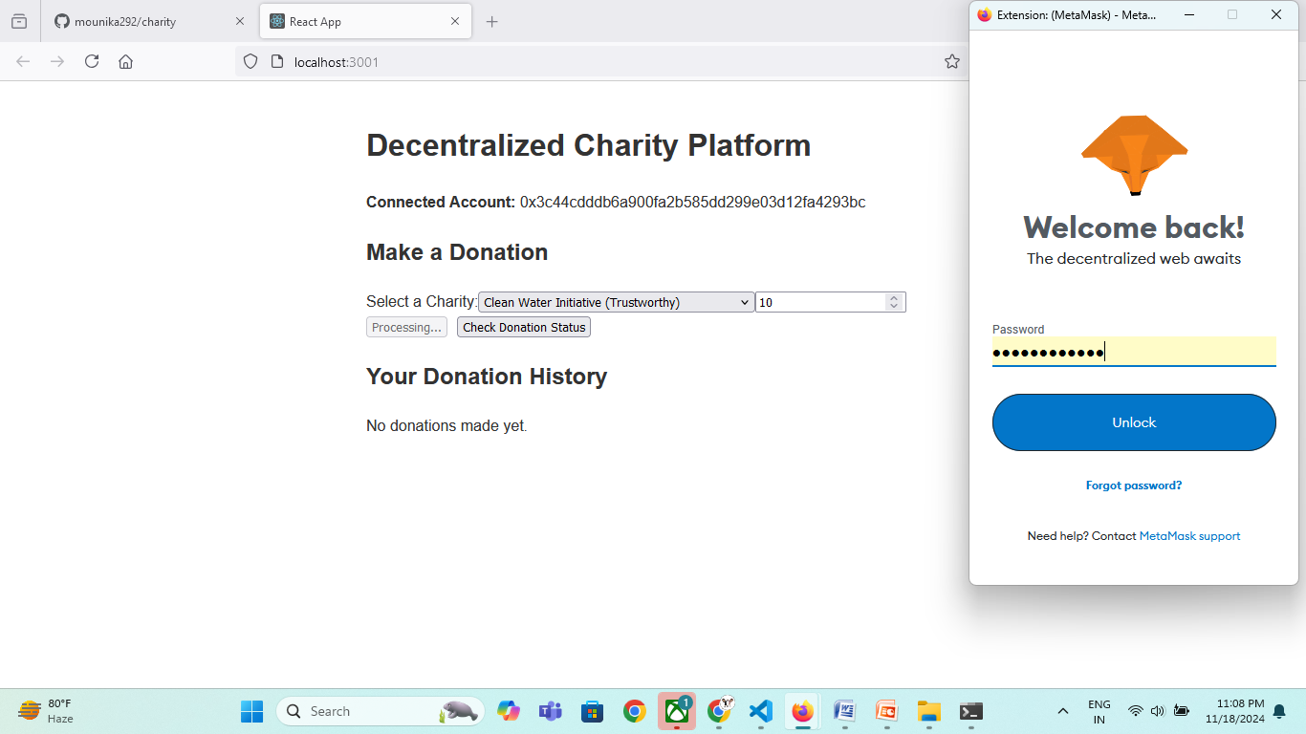

Slide 10
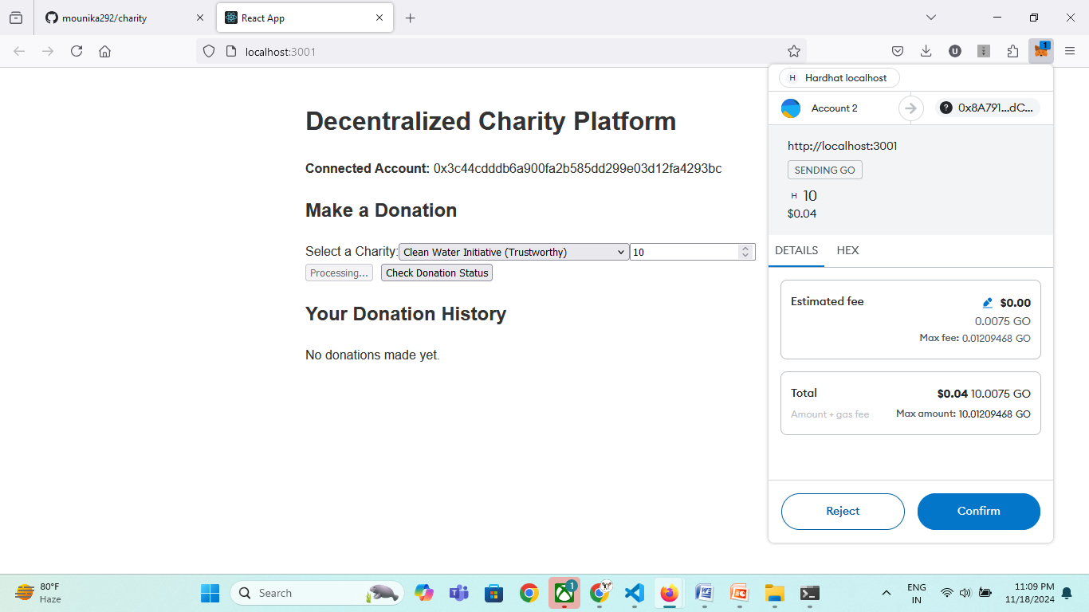

Slide 11
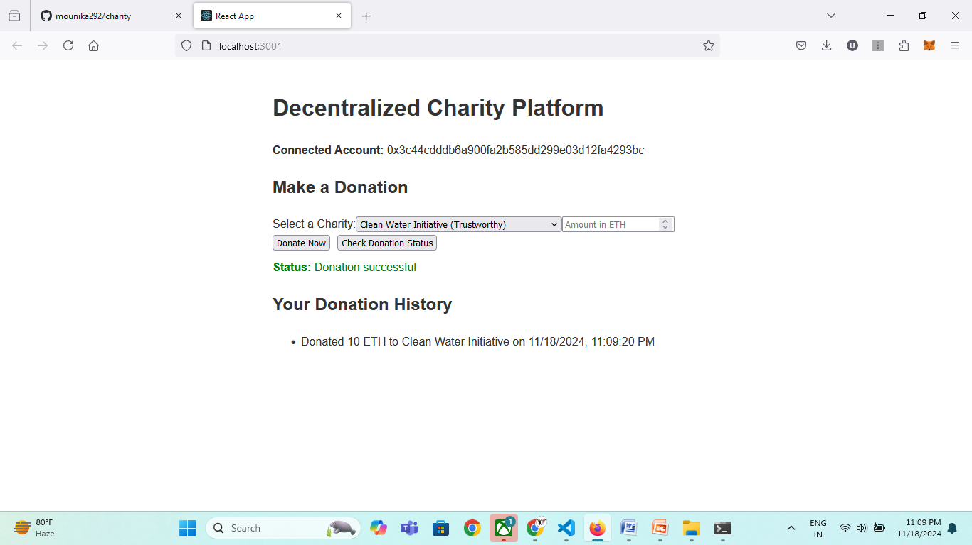

Slide 12
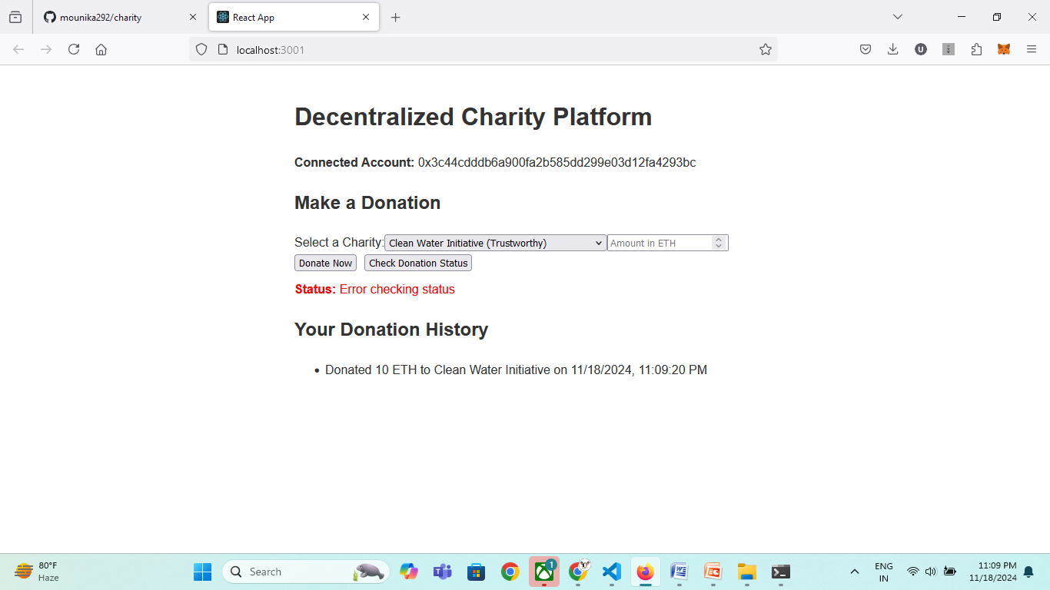

Slide 13
Conclusion
The Decentralized Charity Platform allows users to donate directly to verified charities using Ethereum smart contracts, ensuring transparency and security. It enables users to select charities, make donations in ETH, and track their donation history, all while interacting with the Ethereum blockchain through MetaMask. The platform relies solely on smart contracts deployed on the blockchain to manage donations. This project demonstrates how blockchain can provide a trust and trustless and decentralized approach to charitable donations.

